Slide 1
Web Development
Dr.Soha A. Ehssan

Slide 2
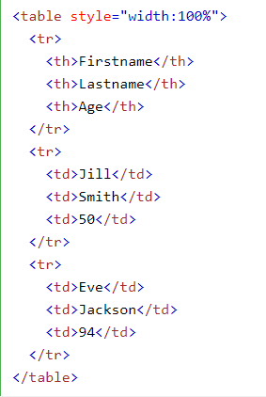
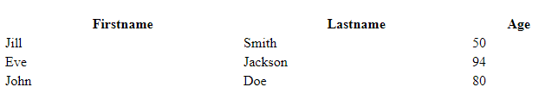
HTML Tables
Table is defined using <table> tag
Each table row is defined by <tr> tag
Table data/cell is defined by <rd> tage
Example
This table consists of 3 rows
The first one is header defined by <th> tag
Each of the other rows consists of 3 cells

Slide 3
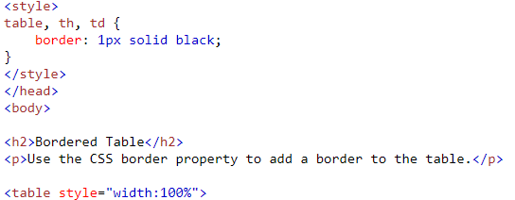
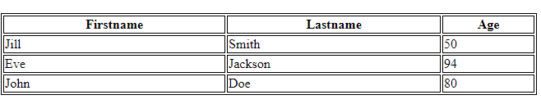
HTML Tables
Adding border to the table
Use css border property
Example

Slide 4


HTML Tables
Adding cell padding
Cell padding specified the space between the cell content and its borders.
Border spacing specifies the space between the cells.

Slide 5
PHP – Delete Record - Example
In order to let the user to select a record from the DB and delete it, we should follow the following steps:
Execute a query to select the required records
Construct a form where each record has a check box to let the user select which record(s) to be deleted
Submit the form to a PHP page to delete the selected records

Slide 6
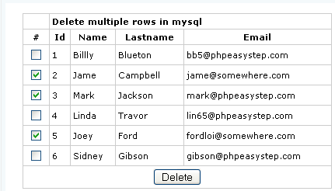
PHP – Delete Record - Example
Form needed to generate

Slide 7
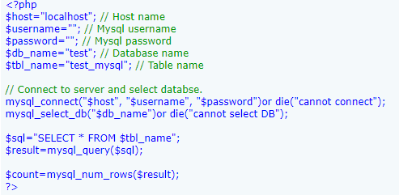
PHP – Delete Record - Example
Example – Part 1 (DB Connection)

Slide 8
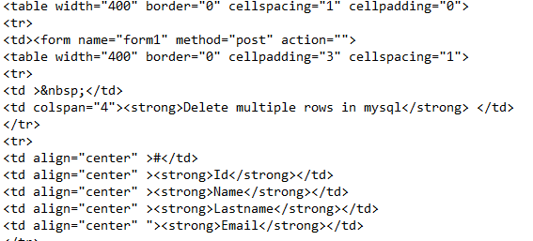
PHP – Delete Record - Example
Example – Part 2 (Form Generation – Table Header)

Slide 9
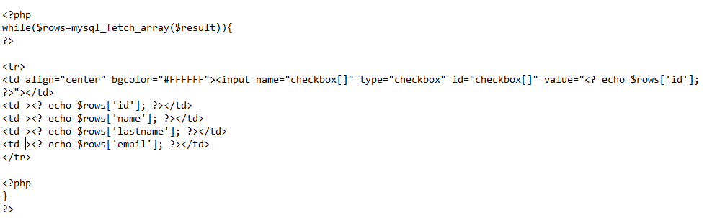

PHP – Delete Record - Example
Example – Part 2 (Form Generation – Table Body)

Slide 10
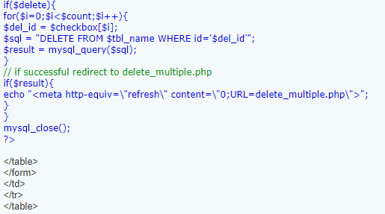
PHP – Delete Record - Example
Example – Part 3 (deleting rows)

Slide 11
PHP – Add and Edit
In order to add new fields to the DB using PHP, data has to be collected via HTML form then inserted into the DB via PHP
Assume the below table:
ID int
Name varchar(100)
Age int
Email varchar(100)

Slide 12
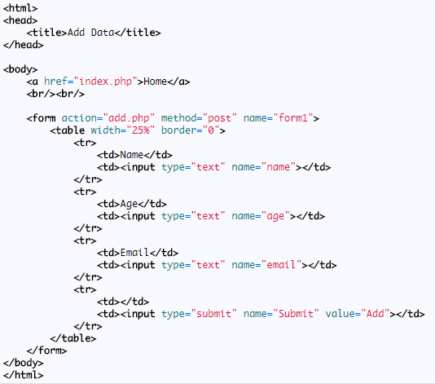
PHP – Add and Edit
HTML form (add.html) ➔ collect data from user

Slide 13
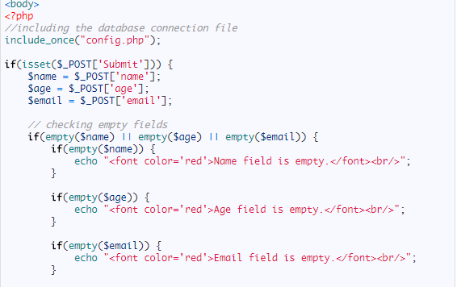
PHP – Add and Edit
PHP insert into table (add.php)
Check for the inserted values

Slide 14
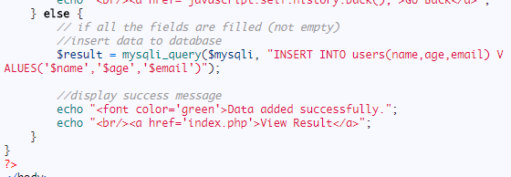
PHP – Add and Edit
PHP insert into table (add.php)
Insert the correct values

Slide 15
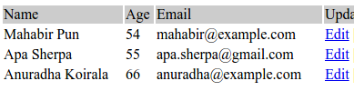
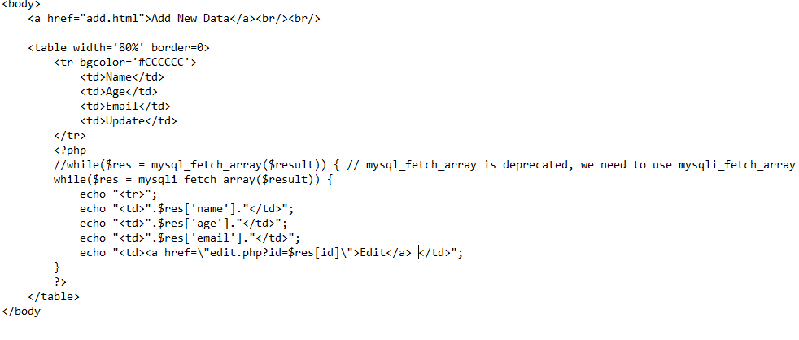
PHP – Add and Edit
PHP Edit data in the table (index.php)
Get the information to let the user select the record to edit

Slide 16
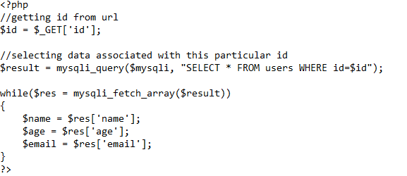
PHP – Add and Edit
PHP Edit data in the table (edit.php)
Get the current values in the field that the user wants to edit.

Slide 17
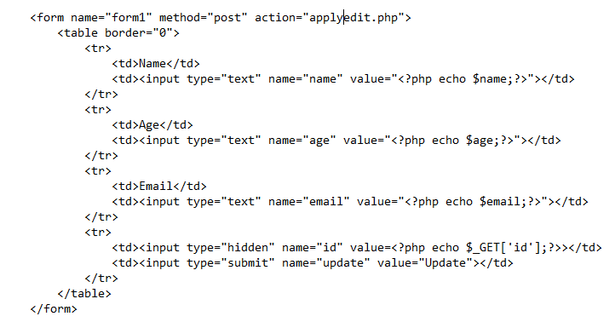
PHP – Add and Edit
PHP Edit data in the table (edit.php)
Open a form inside a table to edit the information.

Slide 18
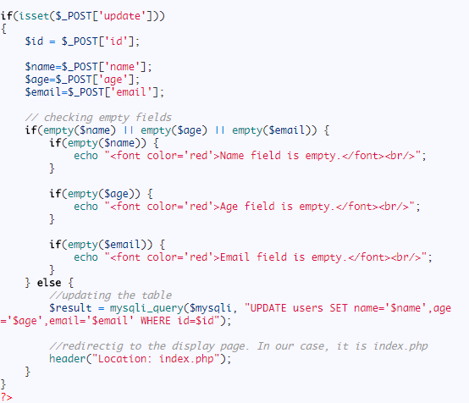
PHP – Add and Edit
PHP Edit data in the table (applyedit.php)
Apply the new values that the user entered.

Slide 19
PHP Filters
PHP Filters are used to
Validating data = Determine if the data is in proper form.
Sanitizing data = Remove any illegal character from the data.
The PHP filter extension has many of the functions needed for checking user input, and is designed to make data validation easier and quicker.
The filter_list() function can be used to list what the PHP filter extension offers

Slide 20
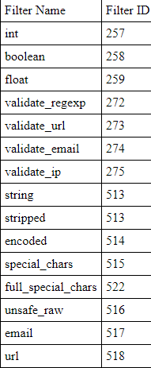
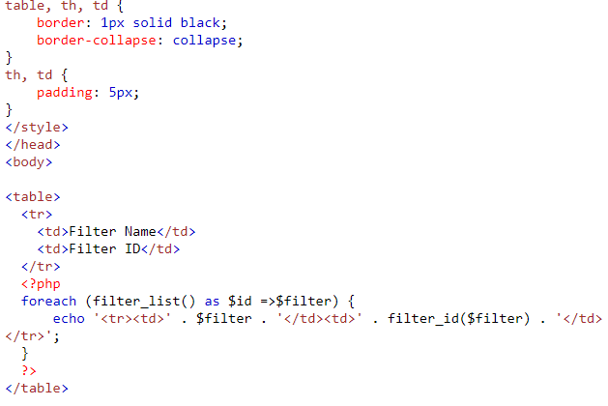
PHP Filters
Example
Notes:
Hint foreach: this form will additionally assign the current element's key to the $key variable on each iteration.

Slide 21

PHP Filters
Why do we use filters?
User input from a form
Cookies
Web services data
Server variables
Database query results

Slide 22
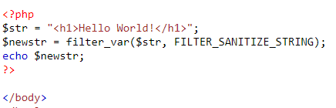

PHP Filters
The filter_var() function both validate and sanitize data.
The filter_var() function filters a single variable with a specified filter. It takes two pieces of data:
The variable you want to check
The type of check to use
example uses the filter_var() function to remove all HTML tags from a string.

Slide 23

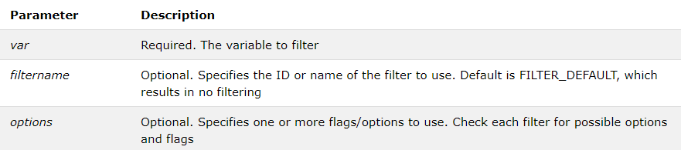
PHP Filters
Filter_var usage:
Syntax

Slide 24
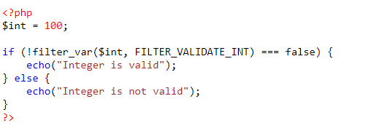

PHP Filters
Validate an Integer
The following example uses the filter_var() function to check if the variable $int is an integer.

Slide 25
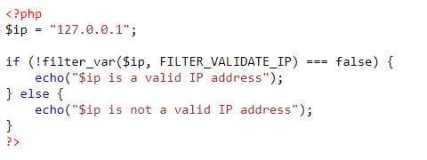

PHP Filters
Validate an IP address
The following example uses the filter_var() function to check if the variable $ip is a valid IP address.

Slide 26
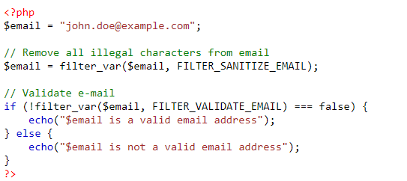

PHP Filters
Sanitize and Validate an Email address
The following example uses the filter_var() function to first remove all illegal characters from the $email variable, then check if it is a valid email address

Slide 27
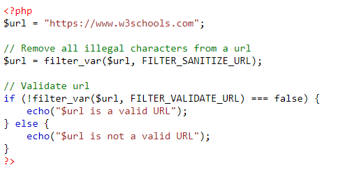

PHP Filters
Sanitize and Validate a URL
The following example uses the filter_var() function to first remove all illegal characters from a URL, then check if $url is a valid URL:

Slide 28
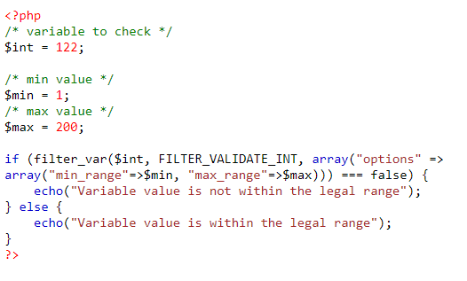

PHP Filters
Validate an Integer within range:

Slide 29
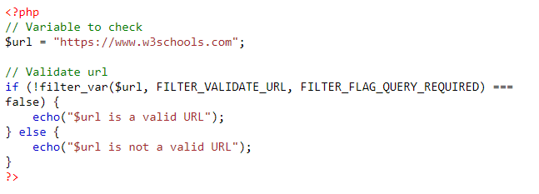

PHP Filters
Validate an a URL with query string (GET parameters):

Slide 30
References
http://www.w3schools.com
http://blog.chapagain.com.np/very-simple-add-edit-delete-view-in-php-mysql/

Slide 31
Thank you

